Slide 1

Community Circle of Care
Iowa’s System of Care Demonstration Project
    Debra Waldron, MD, MPH,FAAP
    Director and Chief Medical Officer
    Child Health Specialty Clinics
    University of Iowa Children’s Hospital
    Debra-waldron@uiowa.edu
    Robert Bacon, Director
    Iowa’s University Center for Excellence
    on Disabilities
    Center for Disabilities and
    Development
    University of Iowa Children’s Hospital
    Robert-bacon@uiowa.edu

Slide 2
Objectives
Describe the progression of building a grassroots System of Care, for youth with emotional and behavioral challenges in Iowa .
Discuss the vision for a comprehensive System of Care (SOC) for Children with Special Healthcare Needs in Iowa (CSHCN).
Describe how the SOC is embedded within the Iowa Title 5 program for Children with Special Healthcare Needs (CSHCN).
Define SOC values, principles, and practice shifts as system is locally built and refined.
Discuss how the System of Care demonstration project has been a good fit for the Iowa UCEDD.
Describe how the SOC initiative is recognized as part of the Iowa Department of Human Services Olmstead Plan.
Notes:
Debra

Slide 3
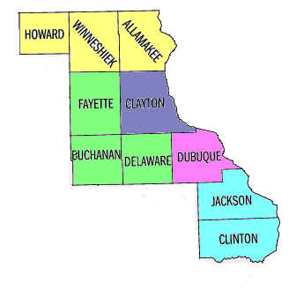
Northeast Iowa
Iowa City
* Des Moines

Slide 4
Progression of State of Iowa and Children’s Mental Health
2005 – Legislature mandates the MH/MR/DD/BI Commission redesign the children’s system. Commission creates workgroup (Children’s Oversight Committee) to make recommendations for improvement.
2006 - Mental Health and Disability Services Division recreated at DHS.
2006 – Oversight Committee finalizes recommendations for a System of Care (SOC) for Iowa’s children.
2006 – DHS receives SAMHSA SOC award.
2007 – Community Circle of Care launched.
2010 - DHS budget cuts lead to some restructuring (e.g. elimination of Children’s Bureau in MHDS), but DHS commitment to Olmstead implementation reinforced.
Notes:
Vickie

Slide 5


Iowa’s Current System
Notes:
Iowa's current system is disjointed, lacks continuity and is disorganized. To families it appears like a big unorganized puzzle, with no guide to show them how to connect the pieces.
Families are lost as to who to call, or where to go for help with their child who has emotional or behavioral needs.
There are other problems with the Iowa system:
There are not specific service requirements for providers. Mental health service providers choose the services they want to provide and choose who they serve. So they tend to provide the services they can bill for and manage easily. For example, crisis intervention is a service that is desperately needed in order to assist children and adults with MH and behavioral concerns, however, this service is expensive, requires after hours and weekend coverage, increases liability, and it requires well trained staff who are paid at market salary or above to prevent burnout with this high stress service.
Appropriate community based mental health services for children, youth, and their families are not available on a consistent statewide basis.
Inpatient and residential service options are utilized when less intensive services in the community may be sufficient. There are long lengths of stay. Waiting lists are also maintained for access to these services.
Its driven by funding streams
There is no one entity that devotes itself to develop and/or provide care for all children with special health care needs. There is no door to enter into a formalized system.
There is limited consistency or continuity across the state. There are many good programs offered by agency with talented staff and very good intentions.

Slide 6
Systems of Care grantees
Maine (3 counties)
Passamaquoddy Tribe, ME
King County, WA
New Hampshire (3 regions)
Maine (4 counties)
Sault Ste. Marie Tribe, MI
Vermont 1 (statewide)
Worcester County, MA
Clark County, WA
Blackfeet Tribe, MT
Bismarck, Fargo, & Minot, ND
Minnesota
(6 counties)
Vermont 2 (statewide)
Worcester, MA
Montana & Crow Nation
Rhode Island 1 (statewide)
Multnomah County, OR
Mid-Columbia Region (4 counties), OR
Minnesota
(4 counties)
Monroe County, NY
Albany County, NY
Rhode Island 2 (statewide)
Sacred Child Project, ND
Wisconsin
(6 counties)
Rhode Island 3 (statewide)
Clackamas County, OR
Bridgeport, CT
Ingham County, MI
Erie County, NY
Southeastern Connecticut
Lane County, OR
Willmar, MN
Westchester County, NY
Idaho
Oglalla Sioux Tribe, SD
Yankton Sioux Tribe, SD
Detroit, MI
New York, NY
Northern Arapaho Tribe, WY
Kalamazoo County, MI
Mott Haven, NY
Iowa
(10 counties)
Cuyahoga County, OH
Burlington County, NJ
United Indian Health Service, CA
Milwaukee, WI
South Philadelphia, PA
McHenry County, IL
Chicago, IL
Allegheny County 1, PA
Wyoming (statewide)
Nebraska
(22 counties)
Lyons, Riverside, & Proviso, IL
Lake County, IN
Allegheny County 2, PA
Glenn County, CA
Southern Consortium
& Stark County, OH
Beaver County, PA
Butte County, CA
Marion County, IN
Delaware (statewide)
Placer County, CA
Montgomery County, MD
Napa & Sonoma Counties, CA
Denver area, CO
Lancaster County, NE
St. Joseph, MO
Alexandria, VA
Baltimore, MD
Sacramento County, CA
Rural Frontier, UT
St. Louis, MO
Northern Kentucky
Charleston, WV
Washington, DC
San Francisco, CA
Contra Costa County, CA
Colorado (4 counties)
Southeastern Kansas
St. Charles County, MO
Eastern Kentucky
Edgecombe, Nash, & Pitt Counties, NC
Urban Trails, Oakland, CA
Sedgwick County, KS
North Carolina (11 counties)
Monterey, CA
Clark County, NV
Southwest Missouri
Nashville, TN
North Carolina (11 counties)
California 5 (Riverside, San Mateo, Santa Cruz, Solano, & Ventura Counties)
Navajo Nation
Mecklenburg County, NC
Oklahoma (5 counties)
Mississippi River Delta area, AR
Maury County, TN
South Carolina (3 counties & Catawba Nation)
Santa Barbara County, CA
California Rural Indian Health Board, Inc., CA
Birmingham, AL
Greenwood, SC
Los Angeles County, CA
Choctaw Nation, OK
Gwinnett & Rockdale Counties, GA
Charleston, SC
San Diego County, CA
Pascua Yaqui Tribe, AZ
Hinds County, MS
Pima County, AZ
Las Cruces, NM
Ft. Worth, TX
Mississippi
(3 counties)
El Paso County, TX
Travis County, TX
Hillsborough County, FL
Harris County, TX
Southeastern Louisiana
Sarasota County, FL
West Palm Beach, FL
Broward County, FL
Fairbanks Native Association, AK
Funded Communities
Wai'anae & Leeward, HI
Date Number
Guam
Yukon Kuskokwim Delta Region, AK
Puerto Rico
1993–1994 22
1997–1998 23
1999–2000 22
2002–2004 29
2005–2006 30
Honolulu, HI
Notes:
6
166 SOC communities have been funded since 1992
Different programs and different target population but the thing that ties them together is the SOC Values and Principles

Slide 7



Community Circle of Care is…
YMCA/YWCA
Four Oakes
DECAT Boards
Empowerment Boards
University of Iowa – Dept of Psychiatry
Kim Conrad Counseling
Family Practice Physicians
Therapists
Bremwood Lutheran Shelter
Hospitals
Community Wellness Centers
Hillcrest Family Services
Pediatricians
Families First
Wal-mart
SAMHSA
NAMI
Schools
Libraries
Multicultural Center
Horizon’s
Families Inc
Elevate
Youth Groups
Crossroads Counseling Center
Juvenile Court Services
Lutheran Services in Iowa
Substance Abuse Service Center
Child Welfare Providers
Visiting Nurse Association
Abby Center
Catholic Charities
Faith Communities
Alternative Treatment Associates
Mental Health America
Mental Health Centers
Community Foundation
The Healing Place
New Directions
Restaurants
Children at Home
Crescent Health Center
Backbone Mental Health Center
Notes:
Community Circle of care is a collaboration among the Iowa Department of Human Services, Iowa Child Health Specialty Clinics (Iowa’s title 5 program), the Center for Disabilities and Development (Iowa’s AUCD program) and other community partners.
Community Circle of care is…
A System of Care for youth with Emotional and Behavioral Challenges in northeast Iowa.
A system transformation initiative that encourages doing business differently, in order to build a service array in local communities that will provide youth and families with the help they need.
A demonstration project for the state of Iowa to model system of care practices
And probably most important to our families it is a local access point to the system, with experts who can get them the help that they want when they need it.

Slide 8



Northeast Iowa with a SOC
Notes:
New – showing organized SOC

Slide 9

Community Circle of Care

Slide 10
What is a System of Care?
A “System of Care” is an organizational philosophy and framework that involves collaboration across agencies, families, and youth for the purpose of improving access and expanding the array of coordinated community-based, culturally and linguistically competent services and supports for children and youth with a serious emotional disturbance and their families. Systems of Care have specific values that must be adhered to in order to form an enduring and transforming system.
www.samhsa.gov 2009

Slide 11
Iowa’s Vision for an Integrated System of Care for Children with Special Healthcare needs.
Children's Oversight Commission Model
  Lighthouse – no wrong door
  Navigators
  Coordinated care plan of services, supports, and resources
  Governance structure
  Family Driven
  Youth Guided
Community Circle of Care Model
  Information and referral - No wrong door
  Care coordinators
  Individualized and coordinated Wrap Around plan for services and supports
  Governance structure including local and regional advisory boards
  Family Driven
  Youth Guided
Notes:
11
CCC Vision -- Children and youth with emotional and behavioral challenges and their families have access to a broad base of community systems of care, that wraps around them to support their health and build resiliency so they can reach their greatest potential

Slide 12

Characteristics of Systems of Care as
Systems Reform Initiatives
FROM
Fragmented service delivery
Categorical programs/funding
Limited services
Reactive, crisis-oriented
Focus on “deep end,” restrictive
Children/youth out-of-home
Centralized authority
Creation of “dependency”
TO
Coordinated service delivery
Blended resources
Comprehensive service array
Focus on prevention/early
intervention
Least restrictive settings
Children/youth within families
Community-based ownership
Creation of “self-help”
12
Pires, S. (2002). Building systems of care: A primer. Washington, D.C.: Human Service Collaborative.
Notes:
12
When implemented and system transformation is allowed to change and grow, these are the things that can happen. Services shift from fragmented to coordinated, resources are blended, community owns the process etc. Children and youth remain in their homes with local community based services in the least restrictive setting.

Slide 13
Frontline Practice Shifts
Control by professionals Partnerships with families/youth (I am in charge) (acknowledging a power imbalance)
Only professional services Partnership between natural and professional supports and services
Multiple case managers One service coordinator
Multiple service plans Single, individualized (meeting needs of agency) family plan (meeting needs of family)
Family/youth blaming Family/youth partnerships
Deficits focused Strengths focused
Mono Cultural Cultural Competence
13
Orrego, M. E. & Lazear, K. J. (1998) EQUIPO: Working as Partners to Strengthen Our Community and Conlan, L. Federation of Families for Children’s Mental Health
Notes:
13
System practices change from professionals controlling the system to families partnering with professionals. Families have a balance in the formation and implementation of the system. Natural supports are valued and utilized as much if not more then paid/professional supports.

Slide 14
Examples of Family Members and Youth
Shifts in Roles and Expectations
Recipient of information re: child’s service plan | Passive partner in service planning process | Service planning team leader
Unheard voice in program evaluation | Participant in program evaluation | Partner (or independent) in developing and conducting program evaluations
Recipient of services | Partner in planning and developing services | Service providers
Uninvited key stakeholders in training initiatives Anger, adversity & resistance | Participants in training initiatives Self-advocacy | Partners and independent trainers Advocacy & peer support
14
Lazear, K. & Conlon, L. (2004). “Primer Hands On” for Family Organizations. Human Service Collaborative: Washington, D.C.
Notes:
14
14
Families and Youth are valuable resources to expand local capacity for support services in the SOC.
Angela Story

Slide 15
Angela’s Family Story

Slide 16
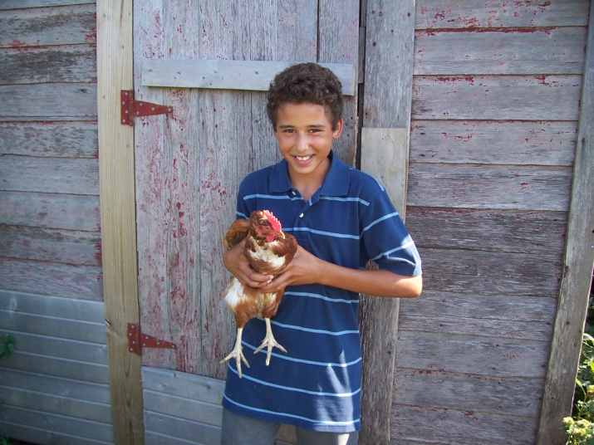
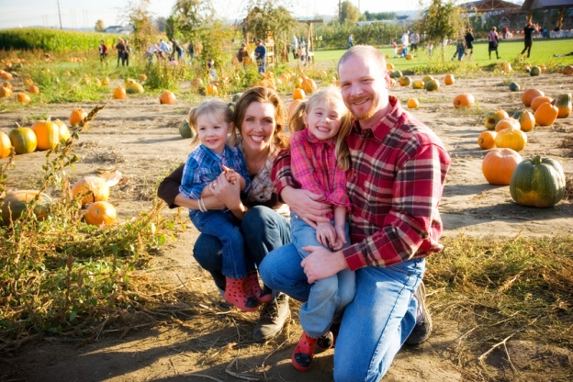


Wrap Around – what is it?
Wrap Around is a planning process that follows a series of
steps, to help children and their families realize their hopes and dreams.
Notes:
Vickie

Slide 17
What Wraparound is Not
A system of care
A new funding source
A “service”
A way to get “stuff” – services that are not typically reimbursable
Only for a small group of kids
Case management
A specific intervention or program
A categorical approach where services reflect what’s available rather than what’s really needed
17
Adapted from Bruns, E. (2004). Ensuring high quality wraparound. Technical Assistance Partnership Webinar and Meyers, MJ. Wraparound Milwaukee,
Milwaukee County Behavioral Health Division, Child and Adolescent Services , & S. Pires, Building System sof Care: A Primer
Notes:
17
Vickie

Slide 18
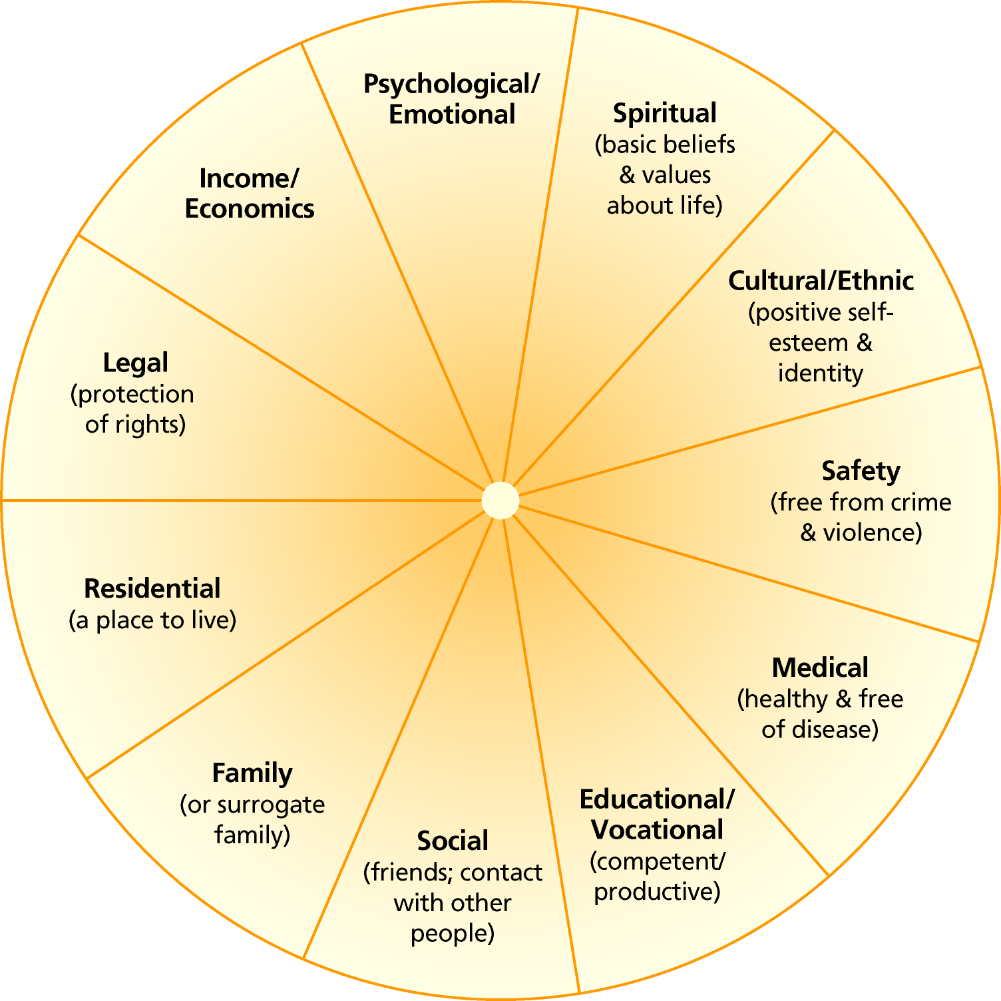
CCC Model of Care
Medical Assessment + Social Supports
Life Domain Areas - addressed in medical assessment
Family Team Meeting
  including natural supports
Medical Assessment and Diagnosis (if needed)
  Multi-disciplinary team
  Tele-medicine
  Medication management
  Practice Parameters
  Return to medical home
Care Coordination
  Linkage to community services
  Social supports

Slide 19


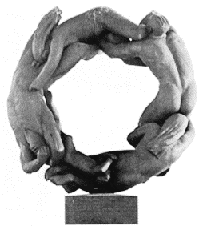
Medical Home Overview
A Medical Home delivers patient centered care where a provider strives to insure timely, accessible, continuous care.
The patient centered goals are formed in partnership with the care provider to enhance care co-ordination of services and health outcomes that are safe, equitable, effective, and culturally sensitive.
19

Slide 21


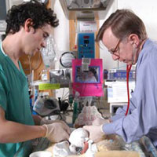


Medical Homes: Must Include the
Whole System of Care - Teamwork
Patients and Families
Primary care physicians
Interdisciplinary health clinicians
Specialists and subspecialists
Hospitals and Healthcare Facilities
Public Health
Community
21
Notes:
21

Slide 22
Care Coordination
Care Coordinators are responsible to navigate the service systems and link the family to needed services. Care Coordinators are nurses, social workers and parent consultants:
  Lead family team meetings
  Develop individualized care plan
  Research resources and make referrals
  Assist with insurance/waiver/support paperwork
  Assist patient/family in coordinating appointments, IEP meetings, etc
  Assist patient/family in finding funding for ancillary services like respite, mentoring, and transportation

Slide 23
Family Team Meeting
Natural Supports identified
Agenda set by family/youth
Community supports the family team meeting concept, (providers attend and provide input, they offer to host meetings at their location)
Families report feeling empowered - like they really have choices.
Barriers to services, or service gaps discovered during family team meetings, are taken to local community advisory meetings for solution focused discussion among stakeholders including family, youth, providers, community members, and other interested stakeholders.
Notes:
Vickie

Slide 24
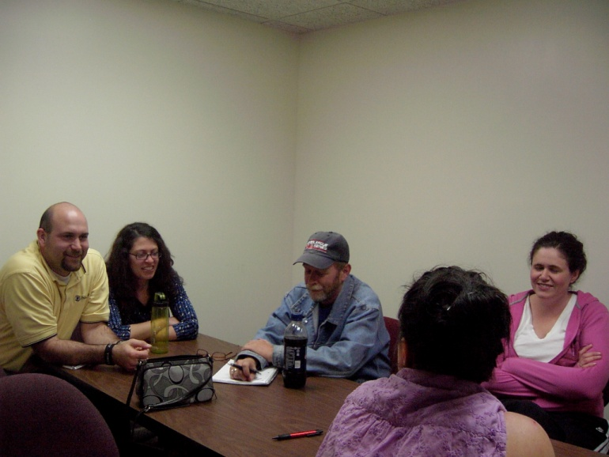
Social Supports - Caregivers
Caregiver and family education
  Parent Consultants provide parent to parent support.
  Parenting classes
  Crisis de-escalation strategies
Support groups
  In local area
  Led by CCC staff and/or a local parent who has been mentored and trained
  These groups provide camaraderie and friendship
Notes:
Nurtured Heart Parenting Class
Behavior Doctor
Parent Management Class

Slide 25
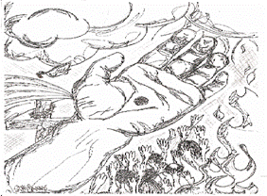
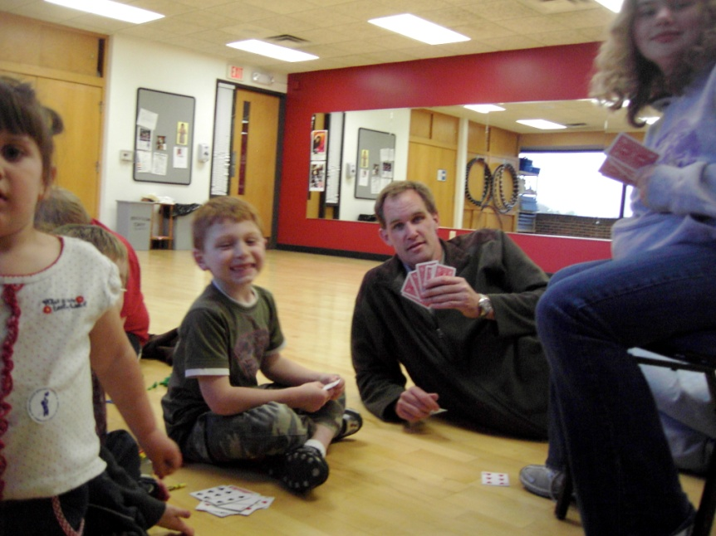

Social Supports - Youth
Youth expression, prevention,
awareness activities
  Digital storytelling
  Art Expression Groups
  Youth Advisory Board
  Elevate

Slide 26
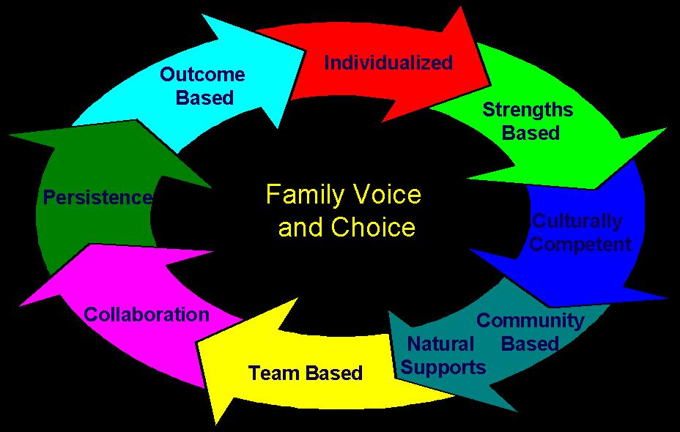
System of Care Values
Family Voice and Choice
Youth Voice and Choice
Strength Based
Culturally Competent
Team Based
Natural Supports
Individualized
Collaboration
Community Based
Outcome Based/Data Driven
Persistence
Notes:
Our SOC is build on these principles.

Slide 27

System of Care Values
Family Voice and Choice. Family and youth/child perspectives are intentionally elicited and prioritized during all phases and levels of SOC development.
Notes:
Families are seen as the expert on their kids. They have choice in all aspects of a SOC including developing policy, programs and services, as well as being the goal setters and leaders for their own child/family.
Are families invited to all meetings that address systems of care issues?
Are families adequately represented on all systems of care committees?
Do the families involved in designing and building systems of care reflect the community's cultural makeup?
Are staff trained in how to engage and involve families?
Are family members employed in the system of care?
Does the individualized care team always involve the family when designing a plan of care?
Do plans of care take into consideration the child and family's cultural and religious/spiritual background?
Do plans of care maximize all natural supports within the family's community?
Are all funding streams being maximized within the interagency makeup of the system of care?
Does the system of care include a flexible fund to help create nontraditional services that are essential to the plan of care for individual children and families?

Slide 28
System of Care Values
Individualized, Strength Based Care
Individualized strengths-based care acknowledges each child and family's unique set of strengths and challenges. Formal and informal supports are used to create services and supports for each child and family (rather than families "fitting in" to preexisting service structures). Issues of culture, gender, age, religious background, and class are addressed in the individualized plan of care. The plan changes frequently based on ongoing individualized assessments of strengths and needs.
Notes:
Does the individualized care team always involve the family when designing a plan of care?
Do plans of care take into consideration the child and family's cultural and religious/spiritual background?
Do plans of care maximize all natural supports within the family's community?
Are all funding streams being maximized within the interagency makeup of the system of care?
Does the system of care include a flexible fund to help create nontraditional services that are essential to the plan of care for individual children and families?

Slide 29

System of Care Values
Culturally Competent
Demonstrates respect for and builds on the values, preferences, beliefs, culture and identify of the child/youth and family and their community.
A defined set of values and principles, as well as behaviors, attitudes, policies, and structures, that enable systems to work effectively cross-culturally
The capacity to value diversity, conduct self-assessment, manage the dynamics of difference, acquire and institutionalize cultural knowledge, and adapt to diversity and the cultural contexts of the communities served
The incorporation of the above in all policymaking, administration, practice, and service delivery, and the systematic involvement of consumers, key stakeholders, and communities
Notes:
Notes about culture. We are going to talk more about culture in a few minutes… but keep in mind that culture is not just about skin color, or heritage, culture is about values, traditions, and how those values and traditions lead families to make certain choices in their lives.
Is leadership committed to the cultural competence effort?
Are policies in place to support cultural competence within the system?
Are the recommended services responsive to each child and family's culture?
Is the family's cultural background taken into account in determining when, how, and where services will be offered?
Are staff reflective of the community's racial and ethnic diversity?
Is staff training regularly offered on the theory and practice of cultural competence?
Are families involved in developing the system's cultural competence efforts?
Do child welfare staff interact with children and families in culturally and linguistically competent ways?
Are staff culturally sensitive to the place and type of services made available to the child and family?
Does the system of care reach out to the diverse racial, ethnic, and cultural groups in the community?

Slide 30
System of Care Values
Outcome Based/Data Driven
Refers to the continual assessment of practice, organizational, and financial outcomes to determine the system of care's effectiveness in meeting the needs of children and families.
Notes:
Do caseworkers use data to monitor their progress and inform decision-making?
Is the management information system designed to capture relevant performance information from all interagency partners?
Have families been involved in the design and implementation of the data system?
Does the management information system track costs, quality of services, and outcomes for children and families?
How does the management information system line up with the federally mandated Child and Family Services Review data?
Does the system of care have a structured process for ongoing performance improvement, including dissemination of key findings to stakeholders, regular review of performance data, and use of outcomes data in decision-making?
Is an ongoing interagency data improvement committee a part of the systems of care infrastructure?
Are data from the management information system used to improve services and supports?
Are data generated from the management information system used to inform the public, legislators, and key policy administrators about the system of care status?
Have cultural competency principles been included in the design of the management information system?
Is the evaluation plan culturally and linguistically appropriate for the community it serves?

Slide 31
System of Care Values
Team Based The SOC team consists of individuals agreed upon by the family and committed to the family through informal, formal and community supports and service relations.
Notes:
Does each member of the team have a fair vote?
Is each team member privy to all information?
Does the family feel like the people around the table are “their team?”
Does the family set the agenda and help define goals and strategies?
How about the youth? Are they a member of the team or are decisions made for them and about them. Are they in the room but people talk as if they are not there?

Slide 32
System of Care Values
Natural Supports The team actively seeks out and encourages the full participation of non paid supports drawn from family members networks of interpersonal and community relationships
Notes:
The wrap around plan reflects activities and interventions that draw on sources of natural support for the family and child. Examples might be a teacher, an athletic coach, a day care provider, a neighbor, a family friend, a Sunday school teacher, the cafeteria lady, a bus driver.
Does the SOC inquire about natural supports?
Does the SOC allow natural supports to be actively involved in assisting the family?
Does the SOC value family connections to community and social supports ?

Slide 33
System of Care Values
Collaboration Team members, including those from a variety of agencies work cooperatively and share responsibility for developing, implementing, monitoring, and evaluating a single wrap around plan.
Notes:
The plan reflects a blending of team members perspectives, mandates, and resources. The plan guides and coordinates each team members work towards meeting the teams goals. It is a single plan, not multiple fragmented ideas.

Slide 34
System of Care Values
Community-Based The wraparound team implements service and support strategies that take place in the most inclusive, most responsive, most accessible, and least restrictive setting possible; and that safely promotes child and family integration into home and community life.
Notes:
Is a broad array of evidence-based and promising practices, informal services, and supports available to meet the needs of children and families in the community?
Are services available to families in their primary language and at times and locations convenient to them?
Is in-home support offered to families?
Are flexible funds available to meet the unique needs of each child and family?
Are all child-serving systems invited to the table and working together on behalf of children and families?
Are caseworkers and staff from collaborating agencies trained in maximizing informal supports for children and families?
Do child welfare caseworkers and other staff interact with children and families in culturally and linguistically competent ways?
Are caseworkers and other staff culturally sensitive to the place and type of services made available to the child and family?
Is the family routinely seen as one of the child's major resources?

Slide 35
System of Care Values
Persistence
Never Give Up!!!

Slide 36

Lesson’s Learned: The process of developing a SOC takes time
Time consuming processes
  Building relationships with individuals, agencies, communities and statewide partners
  Gathering Community Stakeholders and creating a vision
  Spreading the vision to all levels of stakeholders
  Hiring those who strongly identify with SOC values and principles, and who have the resourcefulness to grow a grassroots initiative
Notes:
Debra

Slide 37

Lessons Learned - Community Based Resources
Building on existing Community Based Services is:
  Empowering to the agency providing the service
  Better for youth and families (fewer out of town trips saves gas, energy, and time). Local resources are familiar to the family.
  Creates better relationships with the service agencies and forces communication among providers and the SOC which results in less duplication of efforts.
  SOC values and principals are taught and applied on a local level, creating a common thread between service entities
Notes:
Vickie

Slide 38
Lessons learned - workforce
Workforce issue
  Lack of Psychiatry time
  Lack of Psychiatrists, ARNP’s, and MH professionals specializing in the care of children in Iowa.
  The Iowa board of medicine website lists 34 licensed child/adol psychiatrists in Iowa. www.medicalboard.iowa.gov
Notes:
Debra
The medical board website lists those who are licensed. Some could be retired, or have moved to other states that are not accounted for in this listing.

Slide 39

Notes:
Also developing Mental halth first aid capacity within local communities as a “next step”

Slide 40
System of Care Spread in Iowa
Lyon
Osceola
Dickinson
Emmet
Winnebago
Worth
Mitchell
Howard
*CCC*
Kossuth
Allamakee
Sioux
O'Brien
Clay
Palo Alto
Hancock
Cerro Gordo
Floyd
Chickasaw
Clayton
Plymouth
Buena Vista
Humboldt
Wright
Franklin
Bremer
*CCC*
Cherokee
Pocahontas
Butler
Ida
Black Hawk
Delaware
*CCC*
Woodbury
Sac
Calhoun
Webster
Hamilton
Hardin
Grundy
Buchanan
Boone
Story
Marshall
Tama
Benton
Jones
Jackson
Monona
Crawford
Carroll
Greene
Linn
*CCC*
Shelby
Polk
Jasper
Cedar
Harrison
Audubon
Guthrie
Dallas
Poweshiek
Iowa
Johnson
Scott
Muscatine
Pottawattamie
Cass
Marion
Mahaska
Keokuk
Washington
Adair
Madison
Warren
Louisa
CCC SOC SCOTT
CHSC-RC
ECI SOC
Central IA SOC
Interested in Starting SOC
Montgomery
Lucas
Monroe
Jefferson
Henry
Mills
Adams
Union
Clarke
Wapello
Des Moines
Davis
Van Buren
Fremont
Page
Taylor
Ringgold
Wayne
Decatur
Appanoose
Lee

Slide 41
State SOC Resource Team
Created to bring the SOC projects across the state together
First meeting June, 2010
Established these preliminary goals
  Develop standard data collection tool or common items to report
  Develop consistent message for elected officials
  Establish minimum standards to be a SOC in Iowa
  Link this SOC Resource team to the MH/DD Commission

Slide 42
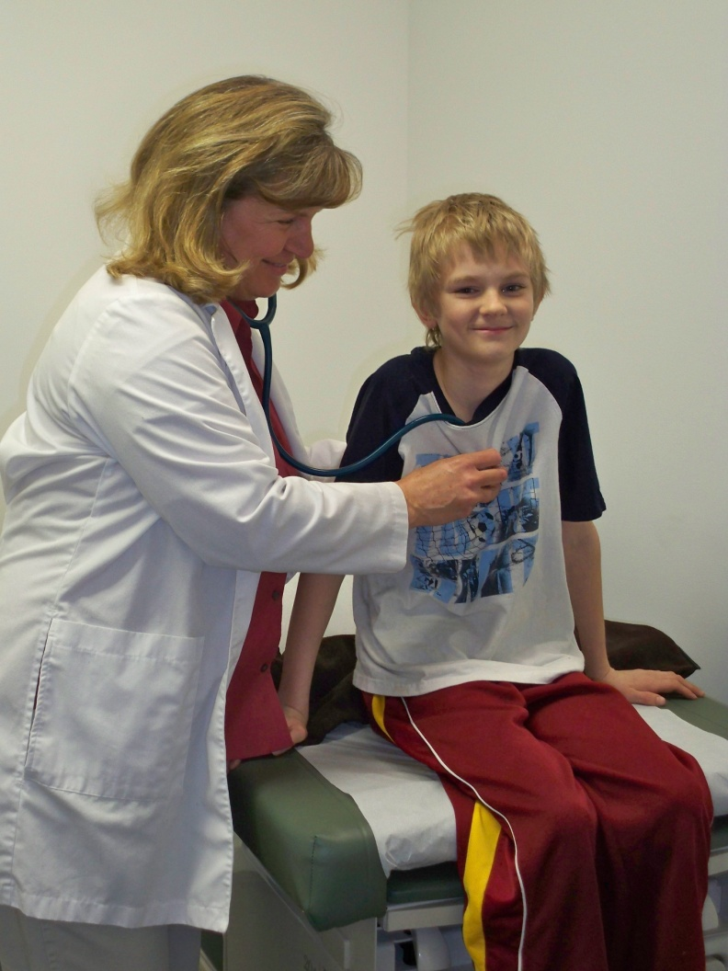
CCC Outcomes
Better accessibility of services
Fewer hospitalizations
Fewer group home/RT placements
Less utilization of PMIC
Decrease in Foster Care placements due to mental health and behavioral challenges of the child.

Slide 43
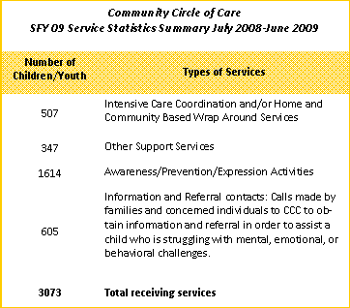
Community Circle of Care Who are we Serving?
Community Circle of Care SFY10 Service Statistics Summary July 2009 – June 2010
Assessment and Diagnostic Services
Assessment and Diagnostic Services
509
836
1,412
623
3,380

Slide 44
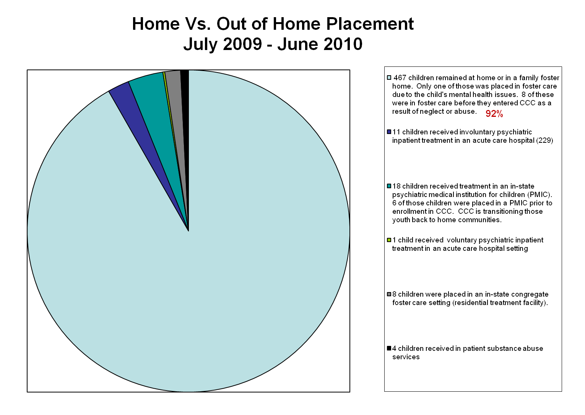
2%
3.5%
.01%
1.5%
1%

Slide 45
91%
3%
2%
1%
1%
1%
.06%

Slide 46
Client Functioning
Outcome improved for 33% of patients at first reassessment
Percent age
Notes:
Results from TRAC which is based on national outcome measure domains, indicate that we have successfully, positively impacted the functioning level of the patient – overall improvement of functioning was sited for 33% of patients from baseline to the first re-assessment N = 752

Slide 47
Social Connectedness
Outcome improved for 10.7% of patients at reassessment
Percent age
Notes:
This chart shows that the rate of self reported Social connectedness improved for 10.7 percent of patients, from baseline to the 6 month re-assessment. N=752

Slide 48
June 2008 – July 2009

Slide 50
SAMHSA Systems of Care & UCEDDs: A Good Fit
An opportunity for UCEDD advocacy, capacity building, and systems change
Taps multiple UCEDD core functions:
  --Service demonstration --Technical assistance
  --Community training --Program evaluation
  --Information dissemination
An opportunity to assist states and communities to create a more unified mental health and disability system that can help parents no matter what disability their child may have

Slide 51
Olmstead and Children’s Mental Health
SAMHSA’s System of Care values align perfectly with principles of Olmstead implementation
Examples:
  Are children needlessly placed in segregated settings?
  Is an appropriate assessment process in place to ascertain what is necessary for kids to be successful in the community?
As with other needed systems improvements, Olmstead puts wind in the sails of needed change.

Slide 52
www.communitycircleofcare.org
    Debra Waldron, MD, MPH,FAAP
    Director and Chief Medical Officer
    Child Health Specialty Clinics
    University of Iowa Children’s Hospital
    Debra-waldron@uiowa.edu
    Robert Bacon, Director
    Iowa’s University Center for Excellence on Disabilities
    Center for Disabilities and Development
    University of Iowa Children’s Hospital
    Robert-bacon@uiowa.edu

